Slide 1
Biost 513 Discussion Section Week 9
Hannah Cohen-Cline

Slide 2
Homework 7
Question 1f
What does it mean to fail to reject the null hypothesis? What do you conclude?
Question 1g
Why can’t you use stcoxkm?
What should you use instead?
What assumptions have we made in our Cox regression model?

Slide 3
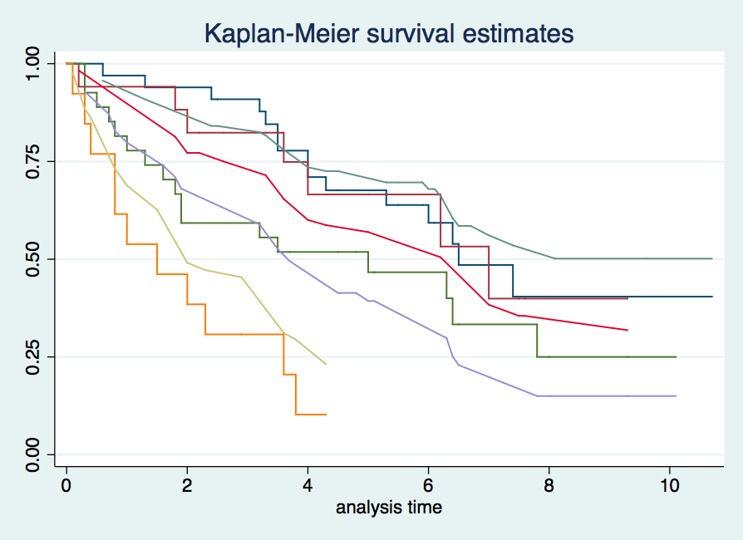
Homework 7

Slide 4
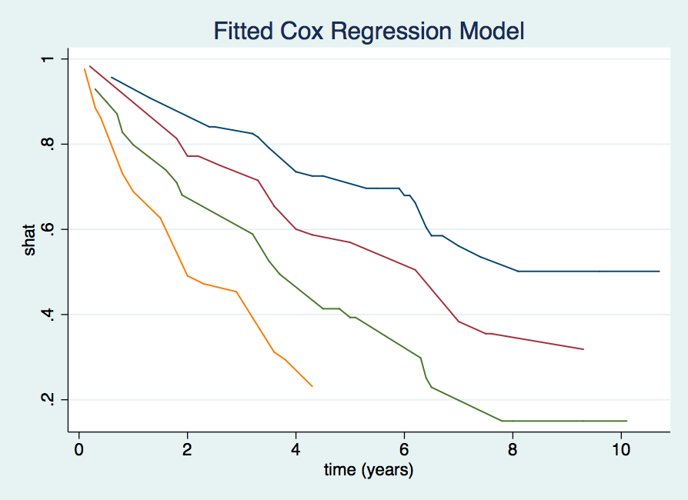
Homework 7

Slide 5
Homework 7
What is the value of the log-likelihood?
Does the HR depend on age and/or sex?
What is our model?

Slide 6
Homework 7
h(t, X) = h₀(t)exp(β_{P}X_{P} + β_{A}X_{A} + β_{S}X_{S} + β_{PA}X_{P}X_{A} + β_{PS}X_{P}X_{S})
What is the HR comparing platelet=1 to platelet=0 for a 50 year old female?
Female is coded as 1
Age is continuous in years
h(t, X) = h₀(t)exp(β_{P}1 + β_{A}50 + β_{S}1 + β_{PA}1*50 + β_{PS}1*1)
h(t, X) = h₀(t)exp(β_{P}0 + β_{A}50 + β_{S}1 + β_{PA}0*0 + β_{PS}0*1)
HR = exp(β_{P} + β_{PA}50 + β_{PS}) = exp(0.470 - 0.008*50 - 0.503 = 0.65

Slide 7
Homework 7
Question 2c
How do you test whether both interactions are equal to 0?
Question 2d
How do you test for confounding?

Slide 8
Case Study Review
Primary biliary cirrhosis of the liver (PBC) is a rare but fatal chronic liver disease, with a prevalence of about 50-cases-per-million population.
Between January, 1974 and May, 1984, the Mayo Clinic conducted a double-blinded randomized trial for PBC, comparing the drug D-penicillamine (DPCA) with a placebo.
424 patients who met the eligibility criteria
312 both treating physician and patient agreed to participate
Disease and survival status as of July 1986, were recorded for as many patients as possible.
125 patients died
11 deaths not attributable to PBC
8 patients lost to follow-up
19 patients underwent liver transplantation

Slide 9
Agenda
Develop a predictive model
Use Cox regression to build "Mayo model” by Dickson et al.
Assess the adequacy of the model
Predict 5 year survival for:
52 year old
serum bilirubin = 0.5 mg/dl
serum albumin = 4.5 gm/dl
prothrombin time = 10.1 sec
no edema/diuretic therapy
Use data on additional patients to check the prognostic model
Conclusions?

Slide 10
Develop a Predictive Model
Why are we doing this?
What should be in the model?
What shouldn’t be in the model?
Do we care about confounders and effect modifiers?

Slide 11
Develop a Predictive Model
What was in the Mayo Model?
age
serum bilirubin
serum albumin
prothrombin time
edema treatment
What does this model look like?
h(t, X) = h₀(t)exp(β_{A}X_{A} + β_{B}X_{B} + β_{Alb}X_{Alb} + β_{P}X_{P} + β_{E}X_{E})

Slide 12
. stcox age edema logbil logalb logpro, nohr
failure _d: status
analysis time _t: time
Cox regression -- Breslow method for ties
No. of subjects = 312 Number of obs = 312
No. of failures = 125
Time at risk = 625985
LR chi2(5) = 196.56
Log likelihood = -541.70071 Prob > chi2 = 0.0000
------------------------------------------------------------------------------
_t | Coef. Std. Err. z P>|z| [95% Conf. Interval]
-------------+----------------------------------------------------------------
age | .0327601 .0085866 3.82 0.000 .0159308 .0495894
edema | .483966 .2373427 2.04 0.041 .0187829 .9491492
logbil | .9017878 .0982848 9.18 0.000 .7091532 1.094422
logalb | -3.097375 .7228942 -4.28 0.000 -4.514221 -1.680528
logpro | 3.184475 1.007283 3.16 0.002 1.210236 5.158714
------------------------------------------------------------------------------

Slide 13
Assess the Model
How do we assess the adequacy of the model?
Proportional hazards
estat phtest
log(-log) plot (stphplot)
stcoxkm
Graphs make it easy to visualize PH, but the interpretation is subjective

Slide 14
Interpretation?
estat phtest, detail
Test of proportional-hazards assumption
Time: Time
----------------------------------------------------------------
| rho chi2 df Prob>chi2
------------+---------------------------------------------------
age | -0.04633 0.23 1 0.6320
edema | -0.22200 5.57 1 0.0183
logbil | 0.12393 1.75 1 0.1854
logalb | -0.03695 0.18 1 0.6717
logpro | -0.18555 3.38 1 0.0661
------------+---------------------------------------------------
global test | 12.40 5 0.0297
----------------------------------------------------------------

Slide 16
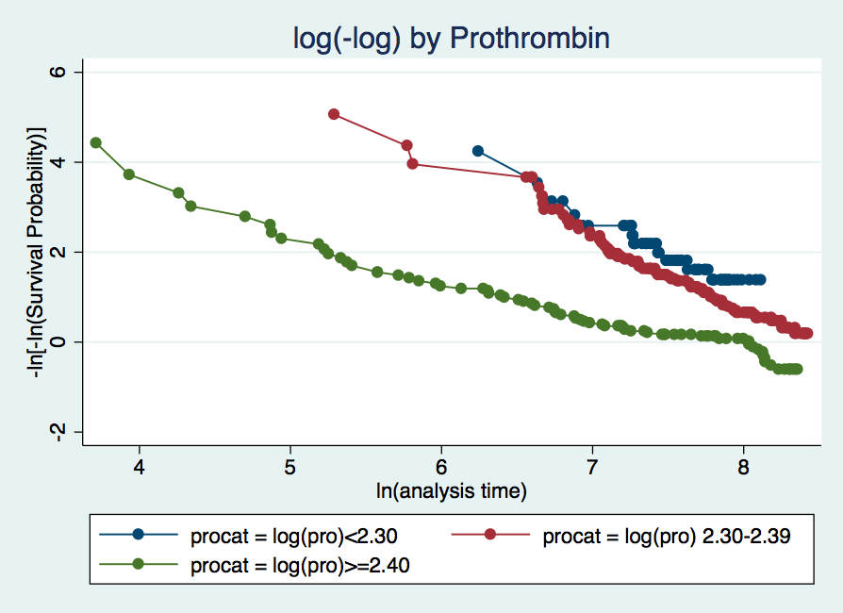

Slide 17
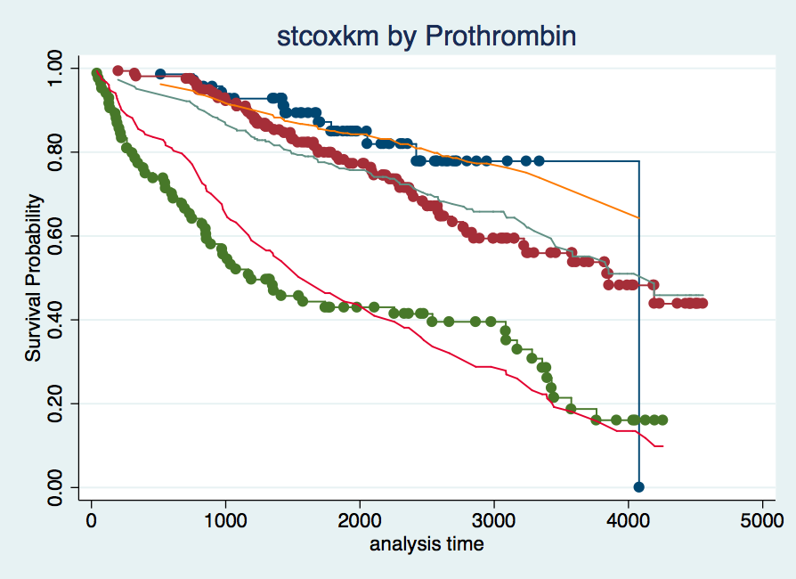

Slide 18
Predict 5-Year Survival
h(t, X) = h₀(t)exp(β_{A}X_{A} + β_{B}X_{B} + β_{Alb}X_{Alb} + β_{P}X_{P} + β_{E}X_{E})
S₀(t=5) = 0.99839 (from Dickenson et al.)
What are our values for X? (Remember some of these need to be log-transformed)
Age = 53
Serum bilirubin = 0.5 mg/dL
Serum albumin = 4.5 gm/mL
Prothrombin time = 10.1 sec
Edema therapy = 0
Notes:
Compare group defined by these x’s to the group where the x’s are 0. For a meaningful comparison, we center the continuous predictors so the reference group has meaningful values.

Slide 19
Predict 5-Year Survival
What is our model?
h(t, X) = h₀(t)exp(β_{A}X_{A} + β_{B}X_{B} + β_{Alb}X_{Alb} + β_{P}X_{P} + β_{E}X_{E})
We have
S(5, X) = S₀(5)^exp(β_{A}X_{A} + β_{B}X_{B} + β_{Alb}X_{Alb} + β_{P}X_{P} + β_{E}X_{E})
Substitute in values for the parameters
S(5, X) = 0.99839^exp(0.033*(53-50) + 0.902*(log(0.5)-0.576) – 3.097*(log(4.5)-1.25) + 3.184*(log(10.1)-2.37) + 0.484*0)
Solve = 0.9998

Slide 20
Internal Validity
What is a concern of assessing internal validity?
Compare observed vs. predicted survival by categories of “log-risk”
stcox age logbil logalb logpro edemaTx, nohr
predict S0hat, basesurv
predict R, xb
generate Rcat = R
recode Rcat (min/4.99999 = 1)(4.5/5.2499999=2)(5.25/6.499999=3)(6.45/max=4)
generate Shat = S0hat^exp(R)

Slide 21
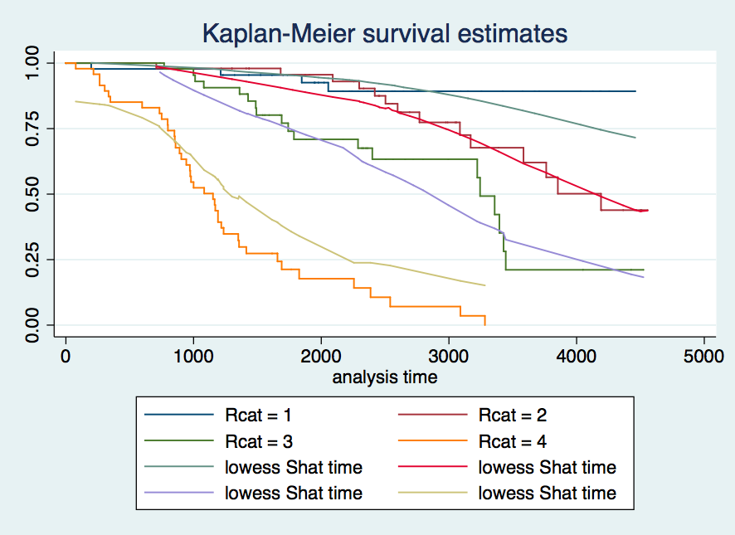

Slide 22
External Validity
Compare observed vs. predicted survival by categories of “log-risk” in an independent dataset
106 subjects did not participate in the trial
This is a little tricky to do in Stata – if you want to see the code, come talk to me

Slide 23
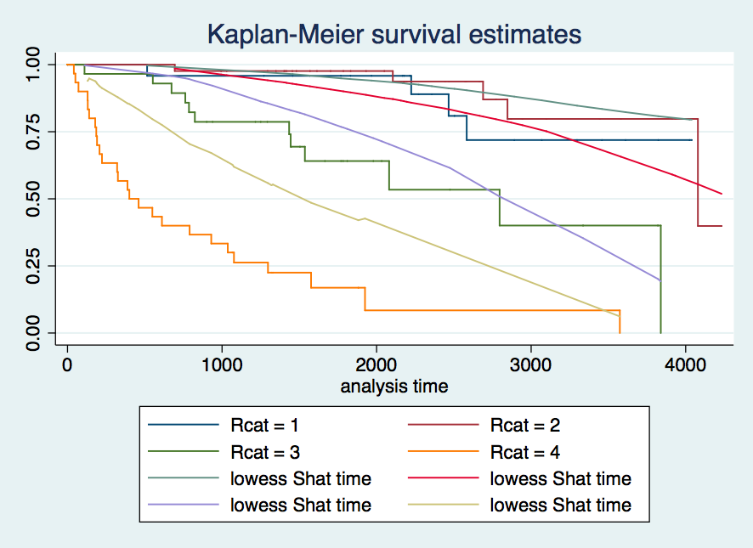

Slide 24
Questions?

